Slide 1
Software Engineering Institute
Capability Maturity Model (CMM)
Notes:
In our software development process, what things are we doing that we need to change?

Slide 2
Capability Maturity Model (CMM)
Implementation
CMM Review
Key Process Areas Key Practices
Company Software Development
Lifecycle/CMM Process Flow
Lifecycle/CMM Process Documentation
Requirements
Design/Project Planning
Coding/Documentation
Build/Test/Release
Notes:
CMM Overview: Capability Maturity Model (a guideline for process and quality improvement in software development) developed and administered through the Software Engineering Institute, an adjunct of the Carnegie Mellon Institute.
Level 2 Key Process Areas: CMM is divided into 5 levels with Key Process Areas at each level. We’ll discuss the KPAs at Level 2 and what they mean to the company.
KPA Process Flow: I’ll discuss how we’re tracing the work flow in each KPA to help us understand where we are and where we need to go.

Slide 3
Why Implement CMM?
To ensure that software projects are:
Completed on time (meet schedule),
Within budget,
Built to quality standard,
Maintainable, and
Meet customer requirements
Notes:
As with any quality initiative, the overriding purpose of the CMM is simple --to improve process and produce a quality product.
You can see the benefits that accrue from this process improvement
These benefits mean one thing: they contribute to the bottom line.
Lower development costs,
Lower defect correction costs by catching defects early in the process
Reduced requirement for production support
Increased customer satisfaction (and referrals).

Slide 4
What Is CMM?
Use project management, process and quality improvement methods for software development and maintenance.
Five progressions, multiple Key Process Areas each level.
Level 2 Key Process Areas:
Requirements Management
Software Quality Assurance
Software Configuration Management
Project Planning
Project Tracking and Oversight
Key Practices define if the process is being followed.
Notes:
As with any quality initiative, the overriding purpose of the CMM is simple --to improve process and produce a quality product.
You can see the benefits that accrue from this process improvement
These benefits mean one thing: they contribute to the bottom line.
Lower development costs,
Lower defect correction costs by catching defects early in the process
Reduced requirement for production support
Increased customer satisfaction (and referrals).

Slide 5
Level 2 Key Practice Focus for Key Process Areas
Management-endorsed policies reflect KPA requirements.
Project resource needs and commitments are met.
Project management / lifecycle processes are defined.
Processes are documented, practiced, and enforced.
Project metrics are collected and tracked.
New projects use experience of prior projects.
All aspects of project are inspected.
Notes:
Bottom line is documented, measurable, repeatable processes that are followed throughout the software development life cycle

Slide 6
Requirements Management
Agreement with customer
Define software specifications, technical and nontechnical
Resolve issues before incorporation into software project
Ensure acceptance criteria is testable
Provide basis for estimating, planning, performing, and tracking software project's activities throughout life cycle.
Adjust software plans, work products, and activities to remain consistent with updated requirements.
Owned by Product Manager
Notes:
Product Manager Responsibility
Key Practice Example:
Ability 2 The allocated requirements are documented and include the nontechnical requirements that affect and determine the activities of the software project and the technical requirements for the software.

Slide 7
Software Quality Assurance
Provide visibility on product quality, project processes
Review, inspect project products to verify compliance with procedures, standards
Assess if project management activities follow CMM processes
Provide managers with reviews, inspections, assessment results
Assist in developing quality, software configuration management plans
Assist in establishing software and project management standards, procedures
Owned by Quality Systems
Notes:
Quality Systems Responsibility
Key Practice Example
Activity 1 A SCM plan is prepared for each software project according to a documented procedure.

Slide 8
Software Configuration Management
Establish, maintain product integrity throughout software life cycle
Identify software configuration items (customer software products and items identified with or required to create software products)
Control changes to configuration
Maintain integrity and traceability of configuration
Establish software baseline library and control builds/releases
Utilize change control and configuration audit functions
Owned by Quality Systems
Notes:
Quality Systems Responsibility
Key Practice Example
Activity 4 The SQA group reviews the software engineering activities to verify compliance.
Will include Inspections from
Requirements to
Design to
Code to
Test Cases to
Formal Acceptance Testing

Slide 9
Project Tracking and Oversight
Provide visibility on project progress
Enable management to act on significant deviation from plan
Compare software size, effort, cost, schedule against estimates
Review commitments with management at selected milestones
Negotiate change with affected groups
Correct problems through revising plan or improving performance
(Looking at MS Project web-based timekeeping system)
Owned by Product , Development or Project Manager
Notes:
Product Manager, Development Manager, Project Manager (role) Responsibility
Key Practice Example:
Activity 5 The size of the software work products (or size of the changes to the software work products) are tracked, and corrective actions are taken as necessary.

Slide 10
Project Planning
Plan for developing software and managing project
Develop statement of work–scope, standards, risks, constraints
Identify work products
Develop estimates–software, documentation size, effort, critical computer resources
Plan project's software engineering facilities and support tools
Establish commitments
Define schedule
Owned by Product, Development or Project Manager
Notes:
Product Manager, Development Manager, Project Manager (role) Responsibility
Key Practice Example:
Activity 3 The software engineering group participates with other affected groups in the overall project planning throughout the project's life.

Slide 14
Requirements Stage
High Level MRD (Marketing Requirements Doc) or Business Case
Start MS Project Schedule to capture effort
Create Use Cases
Develop Requirements from Use Cases
Perform Risk Assessment / Create Risk Management Plan (Constraints, Assumptions)
Amend Quality Plan, SCM Plan for new project
Create Test Cases to validate/inspect Requirements
Start Test Plan
Create Change Control Board
Complete Stage End Reports, Assessments
Notes:
Questions????

Slide 15
Requirements Template in DOORS/Checklist in Word

Slide 16
Software Quality Assurance Procedure in Word

Slide 17
Quality Plan Template and Checklist in Word

Slide 18
Software Configuration Management Plan in Word

Slide 19
Status Meeting Template in Word

Slide 20
Design/Project Planning Stage
Concurrently,
Create Architectural, Logical, Physical Design, Data Models
Develop Software Development Plan
Prepare Work Breakdown Structure for Modules
Estimate Size, Effort, Cost, Critical Computer Resources
Update Test Plan and Test Cases
Update MS Project Plan with WBS tasks
Update SCM Plan with Software Configuration Items
Update Risk Management Plan with Development Risks
Design Review
Complete Stage End Reports, Assessments
Notes:
Questions????

Slide 21
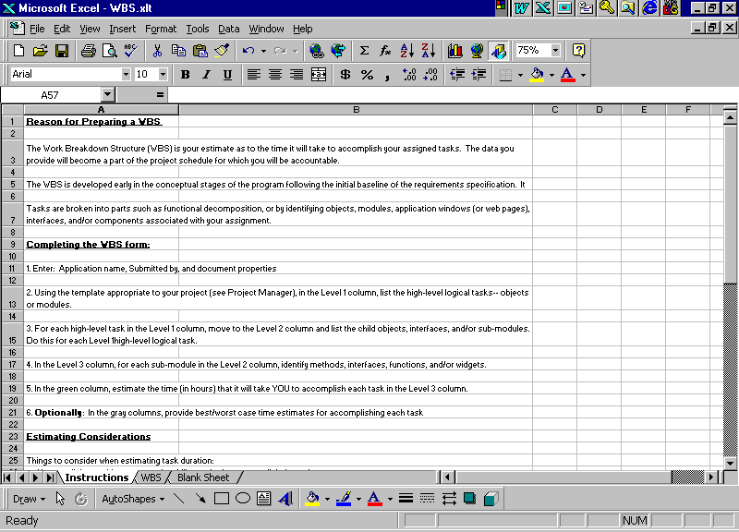
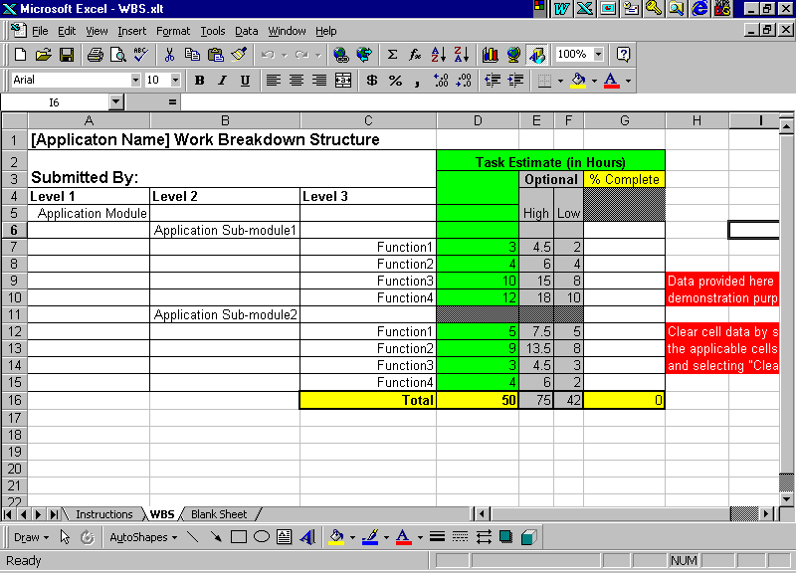
Work Breakdown Structure (WBS) in Excel
Notes:
Questions????

Slide 22
Software Development Plan Template in Word
Notes:
Questions????

Slide 23
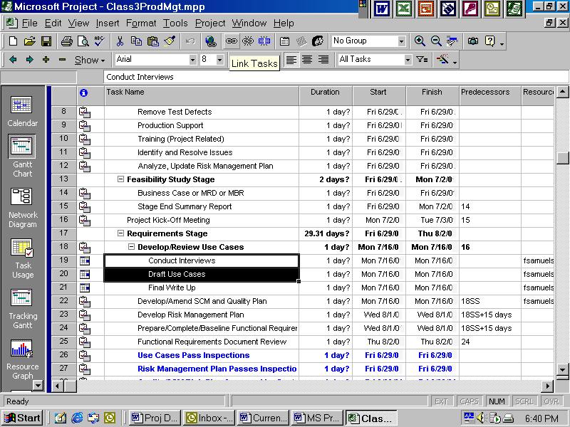
MS Project Plan Template in MS Project
Notes:
Questions????

Slide 24
Coding/Documentation Stage
Code
Update Designs as needed
Start Application Run Book
Unit Tests
Code Reviews
Documentation Reviews
Review Document Help
Review Subject Matter
Receive Technical Input
Integrate Help into Application
Review/Update/Status
Software Development Plan Estimates
SCM Plan Quality Plan
Risk Management Plan MS Project Plan
Finalize Test Plan and Test Cases
Complete Stage End Reports, Assessments
Notes:
Questions????

Slide 25
Application Run Book in Word
Notes:
Questions????

Slide 26
Unit Test Specifications in Word
Notes:
Questions????

Slide 27
Documentation Estimates in Excel
Notes:
Questions????

Slide 28
Build/Test/Release Stage
Authorize Builds
System Tests (MATs, FATs, CRUD, GATs-selected apps)
Document, Track, Resolve Defects
Retest (Regression)
Certify Build for Release
Complete Application Run Book
Deploy Release to Acceptance Test
Complete Stage End Reports, Assessments
Complete Project Post-Mortem
Notes:
Questions????

Slide 29
Change and Release Management Procedure in Word
Notes:
Questions????

Slide 30
Build/Release Notes in Word

Slide 31
The Next Steps
Training in Procedures, Templates and Checklists
for all Development Staff
Hands On Training for Users Relative to Risk and
Requirements Processes
Apply Level 2 Processes to Pilot Projects:
Minor Enhancement Pilot
Major Enhancement Pilot
Major Product Upgrade Pilot or
New Product Pilot
Level 2 Assessment
Begin Preparations for Level 3
Notes:
Questions????

